Slide 1
REVIEW OF OBJECT ORIENTATION

Slide 2
2.1 What is Object Orientation?
Procedural paradigm:
  Software is organized around the notion of procedures
  Procedural abstraction
    Works as long as the data is simple
  Adding data abstractions
    Groups together the pieces of data that describe some entity
    Helps reduce the system’s complexity.
      Such as Records and structures
Object oriented paradigm:
  Organizing procedural abstractions in the context of data abstractions

Slide 3
Object Oriented paradigm
An approach to the solution of problems in which all computations are performed in the context of objects.
  The objects are instances of classes, which:
    are data abstractions
    contain procedural abstractions that operate on the objects
  A running program can be seen as a collection of objects collaborating to perform a given task

Slide 4
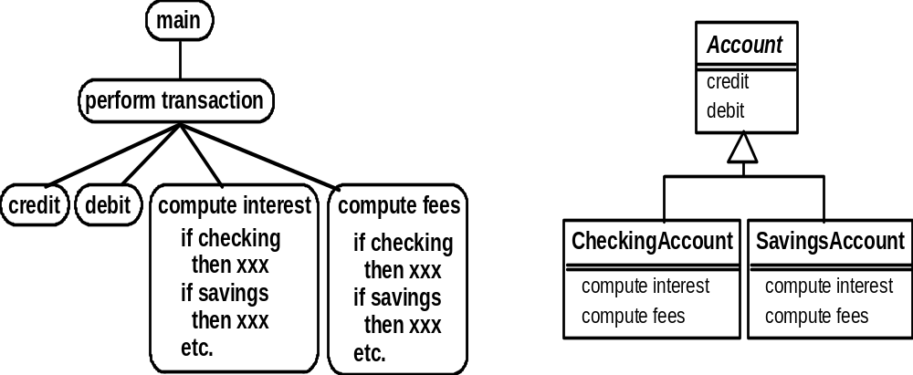
A View of the Two paradigms

Slide 5
2.2 Classes and Objects
Object
  A chunk of structured data in a running software system
  Has properties
    Represent its state
  Has behaviour
    How it acts and reacts
    May simulate the behaviour of an object in the real world

Slide 6
Objects
Jane:
date of birth: 1955/02/02
address: 99 UML St.
position: Manager
Savings Account 12876:
Greg:
balance: 1976.32
date of birth: 1970/01/01
opened: 1997/03/03
address: 75 Object Dr.
Margaret:
date of birth: 1980/03/03
Mortgage Account 29865:
address: 150 C++ Rd.
position: Teller
balance: 198760.00
opened: 2000/08/12
property: 75 Object Dr.
Transaction 487:
amount: 200.00
time: 2001/09/01 14:30
Instant Teller 876:
location: Java Valley Cafe

Slide 7
Classes
A class:
  Is a unit of abstraction in an object oriented (OO) program
  Represents similar objects
    Its instances
  Is a kind of software module
    Describes its instances’ structure (properties)
    Contains methods to implement their behaviour

Slide 8
Is Something a Class or an Instance?
  Something should be a class if it could have instances
  Something should be an instance if it is clearly a single member of the set defined by a class
Film
  Class; instances are individual films.
Reel of Film:
  Class; instances are physical reels
Film reel with serial number SW19876
  Instance of ReelOfFilm
Science Fiction
  Instance of the class Genre.
Science Fiction Film
  Class; instances include ‘Star Wars’
Showing of ‘Star Wars’ in the Phoenix Cinema at 7 p.m.:
  Instance of ShowingOfFilm

Slide 9
Classes
Classes are templates that have methods and attribute names and type information, but no actual values!
Objects are generated by these classes and they actually contain values.
We design an application at the class level.
When the system is running objects are created by classes as they are needed to contain state information.
When objects are no longer needed by the application, they are eliminated.

Slide 10
Class & Objects
CLASS: Furniture
Name
methods: Example
ChangeNumber
Number
Objects:
Desk
ChairA
ChairB
123445
32143
45687

Slide 11
Message Passing & Associations
Methods are associated with classes but classes don’t send messages to each other.
Objects send messages.
A static diagram (class diagram) shows classes and the logical associations between classes, it doesn´t show the movement of messages.
An association between two classes means that the objects of the two classes can send messages to each other.
Aggregation: when an object contains other objects ( a part-whole relationship)

Slide 12
Class Hierarchies & Inheritance
Classes can be arranged in hierarchies so that more classes inherit attributes and methods from more abstract classes
Class hierarchy diagrams
Class: Chair
subclasses
Chair Type A
Chair Type B

Slide 13
Class Inheritance & Specialization
Class name
Class: Furniture
Attribute A1
Method A1
Attributes
Methods
Class: Chairs
[Attribute A1]
Attribute B1
[Method A1]
Method B1
Is a specialization of
Or
Inherits from
Class: Executive Chairs
[Attribute A1]
[Attribute B1]
Attribute C1
[Method A1]
Method B1 (B1 code modified)
Method C1

Slide 14
Public, Private & Protected
Attributes can be public or private:
  Private: it can only be accessed by its own methods
  Public: it can be modified by methods associated with any class (violates encapsulation)
Methods can be public, private or protected:
  Public: it’s name is exposed to other objects.
  Private: it can’t be accessed by other objects, only internally
  Protected: (special case) only subclasses that descend directly from a class that contains it, know and can use this method.

Slide 15
Exercise 1.
Which of the following items do you think should be a class, and which should be an instance? For any item which should be an instance, name a suitable class for it.
General Motors b) Automoible company
Student d) Computer Science Student
Mary Smith f) Game
Board Game h) Chess
Car j) Mazda car
The game of chess between Tom and Jane which started at 2:30pm yesterday
The car with serial number DL 2C 7151

Slide 16
Naming classes
  Use capital letters
    E.g. BankAccount not bankAccount
  Use singular nouns
  Use the right level of generality
    E.g. Municipality, not City

Slide 17
2.3 Instance Variables
Variables defined inside a class corresponding to data present in each instance
  Attributes
    Simple data
    E.g. name, dateOfBirth
  Associations
    Relationships to other important classes
    E.g. supervisor, coursesTaken
    More on these in Chapter 5

Slide 18
Variables vs. Objects
A variable
  Refers to an object
  May refer to different objects at different points in time
An object can be referred to by several different variables at the same time
Type of a variable
  Determines what classes of objects it may contain

Slide 19
Class variables
A class variable’s value is shared by all instances of a class.
  Also called a static variable
  If one instance sets the value of a class variable, then all the other instances see the same changed value.
  Class variables are useful for:
    Default or ‘constant’ values (e.g. PI)
    Lookup tables and similar structures
  Caution: do not over-use class variables

Slide 20
Exercise 2.
Identify the attributes that might be present in the following classes. Try to be reasonably exhaustive.
Passenger (in an airline)
Room (in a Hotel)
Phone Call (in the system of a mobile telephone company)

Slide 21
2.4 Methods, Operations and Polymorphism
Operation
  A higher-level procedural abstraction that specifies a type of behaviour
  Independent of any code which implements that behaviour
    E.g., calculating area (in general)

Slide 22
Methods, Operations and Polymorphism
Method
  A procedural abstraction used to implement the behaviour of a class.
  Several different classes can have methods with the same name
    They implement the same abstract operation in ways suitable to each class
    E.g, calculating area in a rectangle is done differently from area in a circle

Slide 23
Polymorphism
A property of object oriented software by which an abstract operation may be performed in different ways in different classes.
  Requires that there be multiple methods of the same name
  The choice of which one to execute depends on the object that is in a variable
  Reduces the need for programmers to code many if-else or switch statements

Slide 24
Exercise
For each of the following classes, identify the operations that might be present. Highlight potentially polymorphic operations and operations that would make sense in one or two of the three classes.
Square, Circle, Rectangle
Doctor, Patient

Slide 25
2.5 Organizing Classes into Inheritance Hierarchies
Superclasses
  Contain features common to a set of subclasses
Inheritance hierarchies
  Show the relationships among superclasses and subclasses
  A triangle shows a generalization
Inheritance
  The implicit possession by all subclasses of features defined in its superclasses

Slide 26
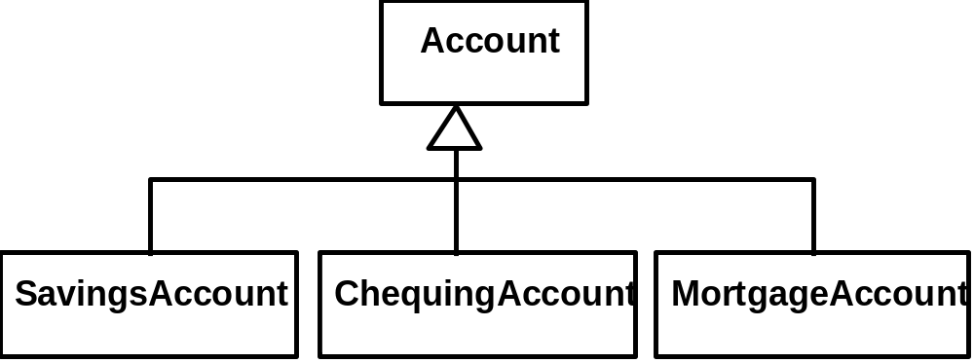
An Example Inheritance Hierarchy
Inheritance
  The implicit possession by all subclasses of features defined in its superclasses

Slide 27
The Isa Rule
Always check generalizations to ensure they obey the isa rule
  “A checking account is an account”
  “A village is a municipality”
Should ‘Province’ be a subclass of ‘Country’?
  No, it violates the isa rule
    “A province is a country” is invalid!

Slide 28
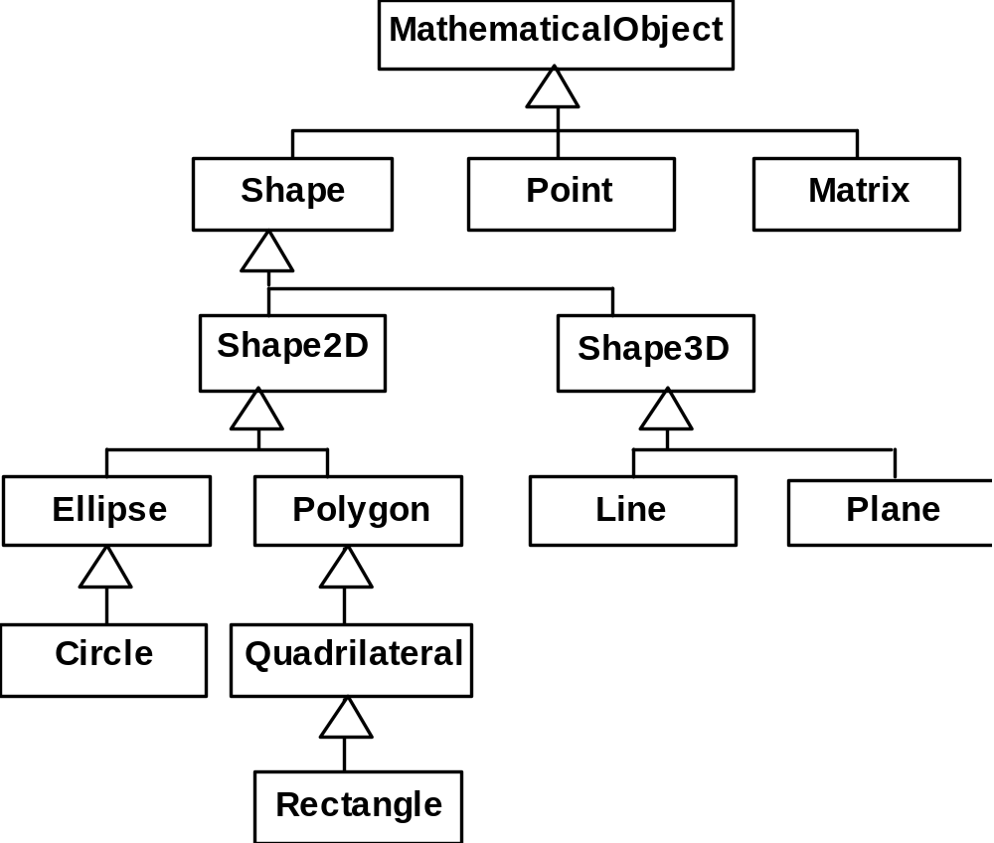
A possible inheritance hierarchy of mathematical objects

Slide 29
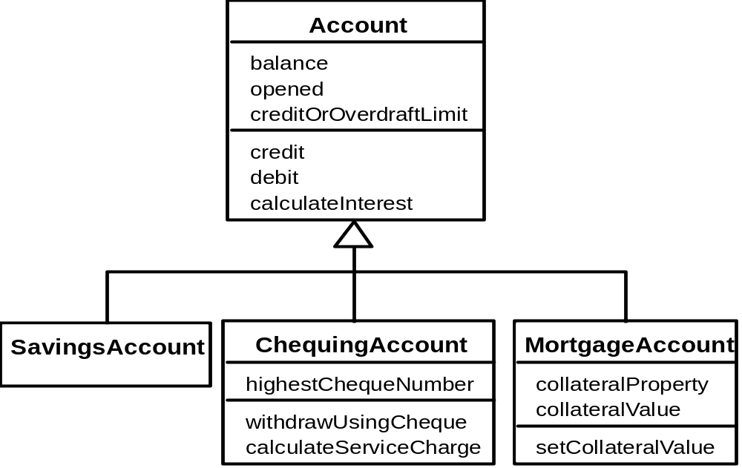
Make Sure all Inherited Features Make Sense in Subclasses

Slide 30
Exercise
Organize the following set of classes into Inheritance hierarchies:
Vehicle Car Sports car
Aero plane Amphibious vehicle Engine
Jet engine Electric Motor Wheel
Truck Bicycle
Video VCR Remote Control
Television Movie Cassette
Copy of movie Audio tape Audio tape deck
Item on tape Copy of CD CD
Song on CD Version of song DVD
“Sound of Music” (the film)

Slide 31
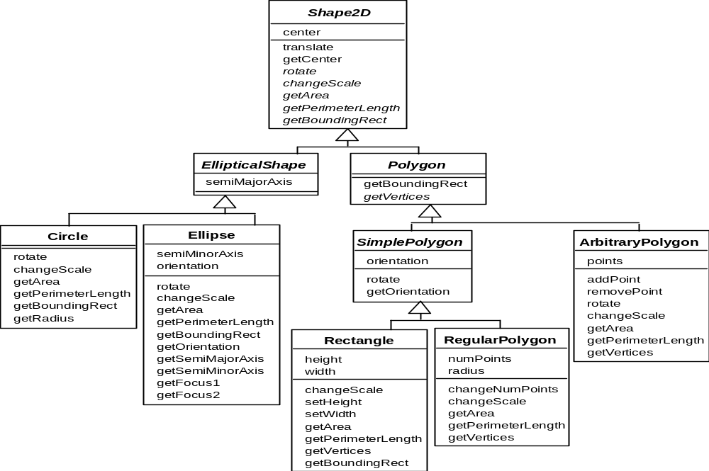
2.6 Inheritance, Polymorphism and Variables

Slide 32
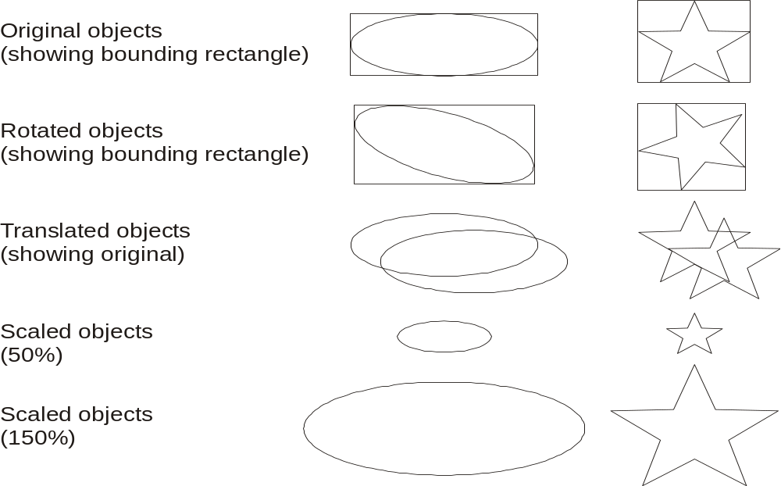
Some Operations in the Shape Example

Slide 33
Abstract Classes and Methods
An operation should be declared to exist at the highest class in the hierarchy where it makes sense
  The operation may be abstract (lacking implementation) at that level
  If so, the class also must be abstract
    No instances can be created
    The opposite of an abstract class is a concrete class
  If a superclass has an abstract operation then its subclasses at some level must have a concrete method for the operation
    Leaf classes must have or inherit concrete methods for all operations
    Leaf classes must be concrete

Slide 34
Overriding
A method would be inherited, but a subclass contains a new version instead
  For restriction
    E.g. scale(x,y) would not work in Circle
  For extension
    E.g. SavingsAccount might charge an extra fee following every debit
  For optimization
    E.g. The getPerimeterLength method in Circle is much simpler than the one in Ellipse

Slide 35
Immutable objects
  Instance variables may only be set when an object is first created.
  None of the operations allow any changes to the instance variables
    E.g. a scale method could only create a new object, not modify an existing one

Slide 36
How a decision is made about which method to run
1. If there is a concrete method for the operation in the current class, run that method.
2. Otherwise, check in the immediate superclass to see if there is a method there; if so, run it.
3. Repeat step 2, looking in successively higher superclasses until a concrete method is found and run.
4. If no method is found, then there is an error
  In Java and C++ the program would not have compiled

Slide 37
Dynamic binding
Occurs when decision about which method to run can only be made at run time
  Needed when:
    A variable is declared to have a superclass as its type, and
    There is more than one possible polymorphic method that could be run among the type of the variable and its subclasses

Slide 38
2.7 Concepts that Define Object Orientation
Necessary for a system or language to be OO
  Identity
    Each object is distinct from each other object, and can be referred to
    Two objects are distinct even if they have the same data
  Classes
    The code is organized using classes, each of which describes a set of objects
  Inheritance
    The mechanism where features in a hierarchy inherit from superclasses to subclasses
  Polymorphism
    The mechanism by which several methods can have the same name and implement the same abstract operation.

Slide 39
Other Key Concepts
Abstraction
  Object -> something in the world
  Class -> objects
  Superclass -> subclasses
  Operation -> methods
  Attributes and associations -> instance variables
Modularity
  Code can be constructed entirely of classes
Encapsulation
  Details can be hidden in classes
  This gives rise to information hiding:
    Programmers do not need to know all the details of a class

